Slide 1
Lecture:5 A Closer Look At Classes Prepared By: Sumaiya Binte Shahid Lecturer Department of CSE, BUBT

Slide 2
Assigning Objects

Slide 3
Assigning Objects
One object can be assigned to another provided that both objects are of the same type.
By default when one object is assigned to another, a bitwise copy of all the data members is made.
All data members (including array, string) of one object are assigned to another when an assignment is performed.
For example when an object called ob1 is assigned to another object ob2 ,the content of all of ob1’s data are copied into equivalent member of ob2.

Slide 4
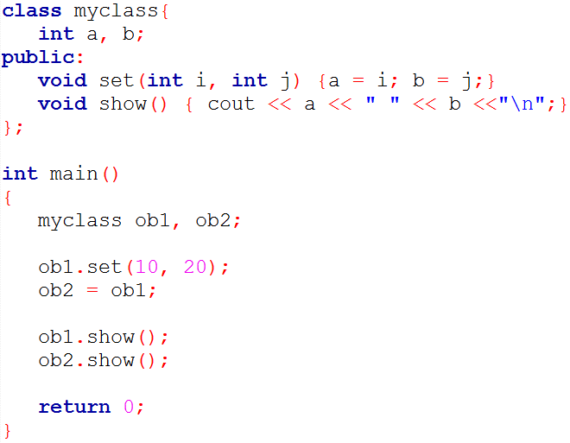
What will be the OUTPUT?

Slide 5
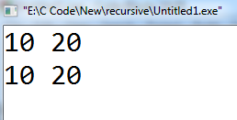
What will be the OUTPUT?
Here, object o1 has its member variables a and b set to the values 10 and 20, respectively. Next, o1 is assigned to o2. This causes the current value of o1.a to be assigned to o2.a and o1.b to be assigned to o2.b. Thus, when run, this program displays this output.

Slide 6
Assigning Objects
Only objects of same type can be used in an assignment statement.
If the objects are not of same type then a compile time error is reported.
It is not sufficient that the types just be physically similar –their type name must be similar.

Slide 7
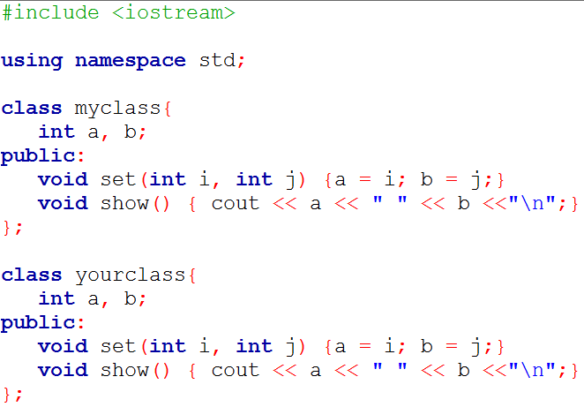
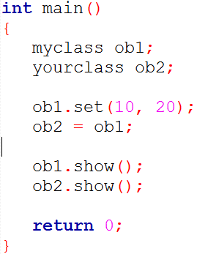
What will be the OUTPUT?
Error

Slide 8
Passing Object To Function

Slide 9
Passing Object To Function
Objects can be passed to functions as arguments in just the same way that other types of data are passed.
Simply declare the function’s parameter as a class type.
Then use an object of that class as an argument when calling the function.

Slide 10
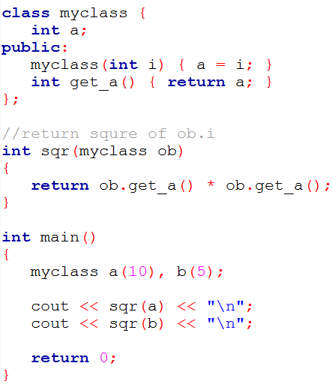
Example

Slide 11
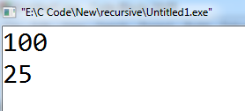
Output !!
This program creates a class called samp that contains one integer variable called i. The function sqr it() takes an argument of type samp and returns the square of that object’ I value. The output from this program is 100 followed by 25.

Slide 12
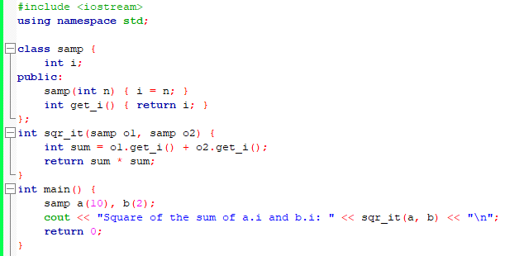
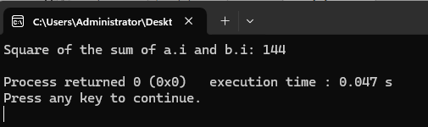
Example

Slide 13
Ways of Passing Arguments to Function (Call by Value and Call by Reference)

Slide 14
Call by Value
The default method of parameter passing in C++ including objects is by value.
This means that a bitwise copy of the argument is made and it is this copy that is used by the function.
Any changes made to the parameters within the function do not change the original values outside the function.
As with other types of data, by default all objects are passed by value to a function.

Slide 15
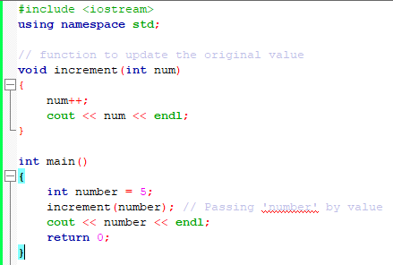
Example

Slide 16
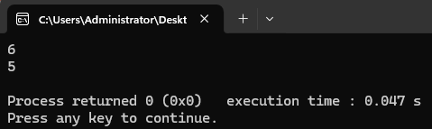
Output !!
Explanation: In the above program the “number” is passed as an actual parameter to the function increment and in the function as a formal parameter “num” that stores the value of “number”. In the function, the value of “num” is incremented but there is no change in the value of “number”. This is what we say “call by value”.

Slide 17
Call by Reference
In the call by reference method, the memory address (reference) of the actual parameter is passed to the function, allowing direct access and modification of the original values.
The actual and the formal parameters point to the same memory address.
Any changes made to the parameters within the function are directly reflected in the original values outside the function.

Slide 18
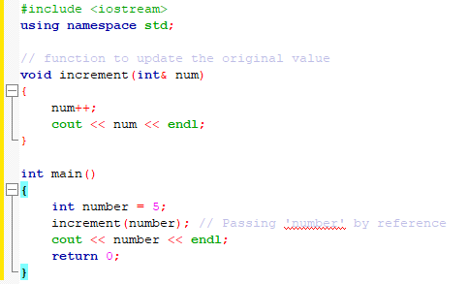
Example

Slide 19
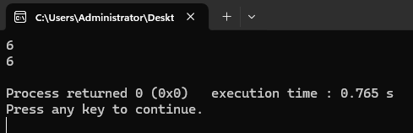
Output !!
Explanation: In the above code the variable “number” is passed to function increment. A formal parameter “num” points to the same address as “number”. When the function increments the value of the parameter, the changes made in “num” is reflected in “number” as we can see from the output. This is what we say “call by reference”.

Slide 20
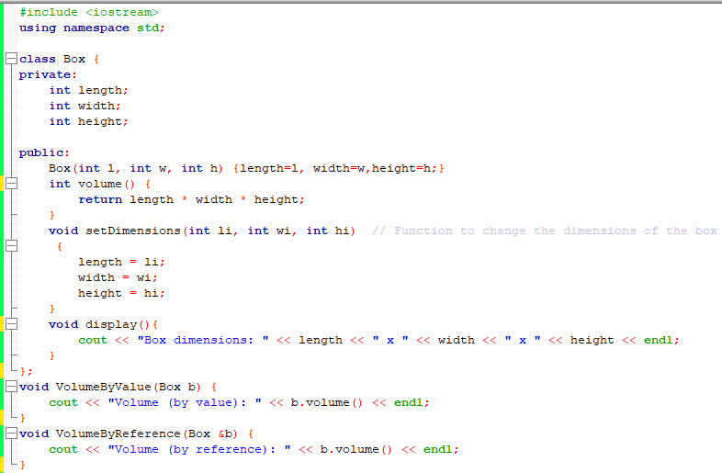
Example

Slide 21
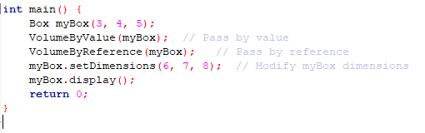
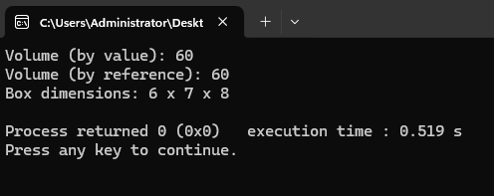
Example

Slide 22
Returning Objects From Functions

Slide 23
Retuning Objects
Functions can return objects.
Declare the function as returning a class type.
Return an object of that type using the normal return statement.

Slide 24
Retuning Objects
When an object is returned by a function, a temporary object is automatically created which holds the return value.
It is this object that is actually returned by the function.
After the value has been returned the object is destroyed.

Slide 25
Example
class MyClass {
int a;
public:
void set_a(int n) { a = n; } // Member function
void show_a() { cout << "a = " << a << endl; } // Member function
};
MyClass createObject() { // MyClass is the return type here
MyClass obj; // Create an object of MyClass
obj.set_a(42); // Set its member variable 'a'
return obj; // Return the object
}
int main() {
MyClass m = createObject(); // Call the regular function
m.show_a(); // Use the object returned by the function
return 0;
} Output: a=42

Slide 26
Friend Class
A friend class in C++ can access private and protected members of another class.
It is declared using the friend keyword.
Friendship is not mutual; it must be explicitly granted.
A friend class declaration typically appears within the class definition but can also be declared separately.
Useful when two classes need to access each other's private members without using member functions. For example, implementing operator overloading for arithmetic operations.

Slide 27
Example
class A {
private:
int x;
public:
friend class B; // B is a friend of class A
};
class B {
public:
void display(A obj) {
// Can access private member x of class A
cout << "Value of x: " << obj.x << endl;
}
};

Slide 28

Friend Functions

Slide 29
Friend Function
Sometimes we want to access the private members of a class without that function actually being a member of that class.
A friend function is not a member function of a class but still has access to its private and protected members of that class for they are declared as friends. A friend function can be:
A global function [friend return_type function_name (arguments);]
A member function of another class[friend return_type class_name::function_name (arguments);]

Slide 30
Friend Function Characteristics
A friend function is a special function in C++ that in spite of not being a member function of a class has the privilege to access the private and protected data of a class.
A friend function is a non-member function or ordinary function of a class, which is declared as a friend using the keyword “friend” inside the class. By declaring a function as a friend, all the access permissions are given to the function.
The keyword “friend” is placed only in the function declaration of the friend function and not in the function definition or call.
A friend function is called like an ordinary function. It cannot be called using the object name and dot operator. However, it may accept the object as an argument whose value it wants to access.
A friend function can be declared in any section of the class i.e. public or private or protected.

Slide 31
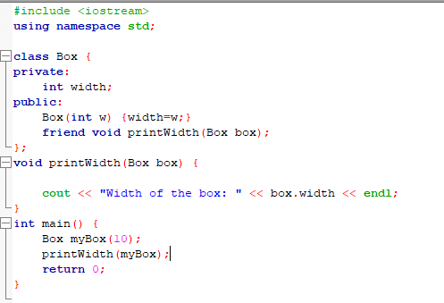
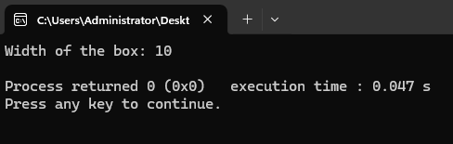
Example

Slide 32
Friend Functions (For a global function)

Slide 33
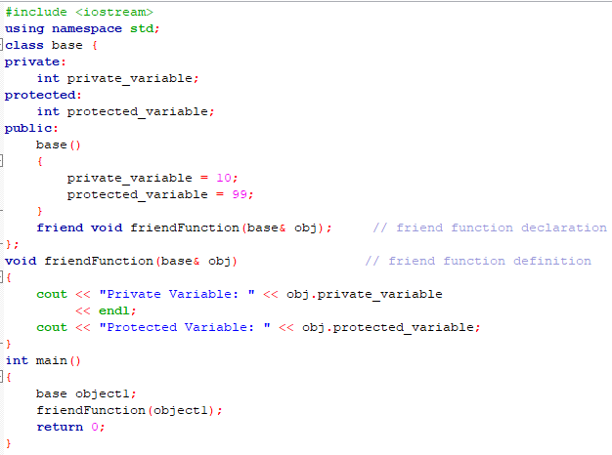

Slide 34
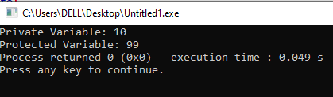
Output !!
Explanation: In the above example, we have used a global function as a friend function. In the next example, we will use a member function of another class as a friend function.

Slide 35
Friend Functions (A member function of another class)

Slide 36
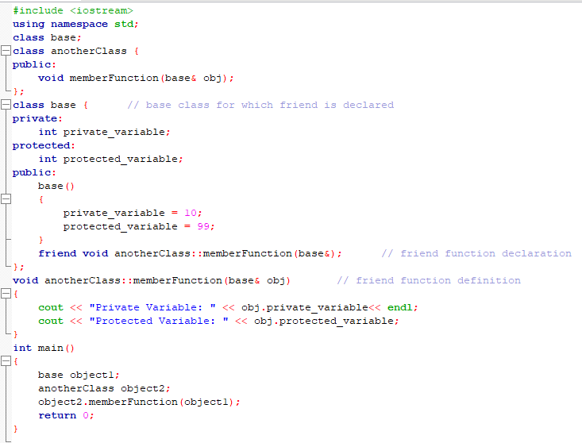

Slide 37
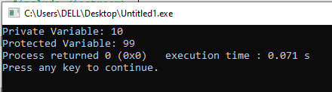
Output !!
Explanation: The order in which we define the friend function of another class is important and should be taken care of. We always have to define both the classes before the function definition. That’s why we have used out of class member function definition.

Slide 38
Friend Function
A friend function is defined as a regular nonmember function.
However inside the class declaration for which it will be a friend its prototype is also included prefaced by the keyword friend.
But it is not member of that class.

Slide 39
Advantages and Disadvantages
Advantages of Friend Functions
A friend function is able to access members without the need of inheriting the class.
The friend function acts as a bridge between two classes by accessing their private data.
It can be used to increase the versatility of overloaded operators.
It can be declared either in the public or private or protected part of the class.
Disadvantages of Friend Functions
Friend functions have access to private members of a class from outside the class which violates the law of data hiding.
Friend functions cannot do any run-time polymorphism in their members.

Slide 40
You are required to implement a class, Point2D. The Point2D class contains private member x. Implement a parameterized constructor to initialize the value. There is a global function calculateDistance(), which takes two Point2D objects as parameters and is declared as a friend of the Point2D class, allowing it to access the private member x. The calculateDistance() function calculates the distance. In the main function, create two Point2D objects, display their x value, and use the calculateDistance() function to compute and output the distance between the x value of two objects.

Slide 41
Create a program that stores and compares the marks of two students.
Define a class Student that has: A private data member marks to store the student's marks. A constructor to initialize the marks.
Write a friend function findTopper(Student s1, Student s2) that: Compares the marks of the two students. Prints the name of the student with higher marks.

Slide 42
Thank You

